Slide 1

Creating powerful data analysis applications with dash in python
Jimmy Calvo Monge

Slide 2

Hello!
My name is Jimmy Calvo Monge and I’m a data scientist / statistician working at the MPE Statistics and Data Analysis Team, at APF TLO.
In my work I develop dashboards and tools for data analysis / visualization … and I use a python library called dash to do that.
NAME OF SESSION

Slide 3

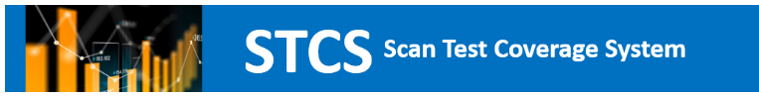
Apps using dash:
You might have seen our morning presentation about WANDA. This is a PPV data dashboard done completely in dash.
Another tool in the TLO Office is the STCS dashboard. This is done to quantify and visualize scan data.
goto/wanda
goto/stcs

Slide 4

Why are we giving this talk?
Dash has been useful for our teams in developing these tools.
Through dash we were able to solve some visualization and UX requirements. We have expanded our tool’s capabilites.
Hence, today I would like to share the advantages, basic usage and our experiences with dash.

Slide 5
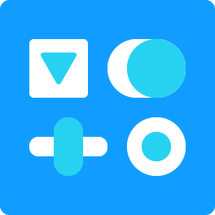


Contents:
Why should I use dash?
Usage of dash:
The layout – callbacks connection: overall idea.
Creating a layout: completely customize your design!
Developing callbacks: what’s going to happen in your dashboard?
Suggested scaffolding for your application.
Examples:
Advanced options, documentation, tips for publishing.

Slide 6
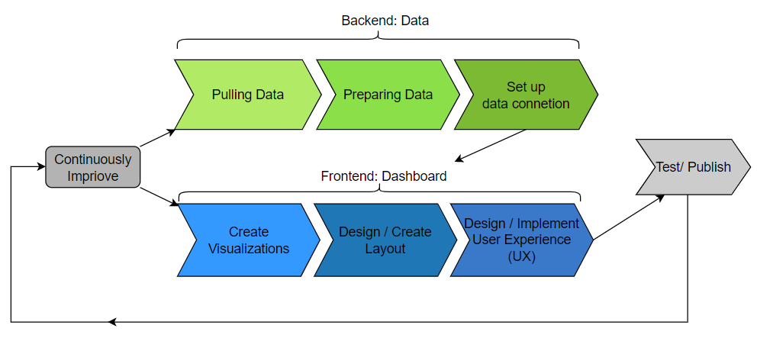
Why should I use dash?
How a dashboard works fully:
NAME OF SESSION

Slide 7
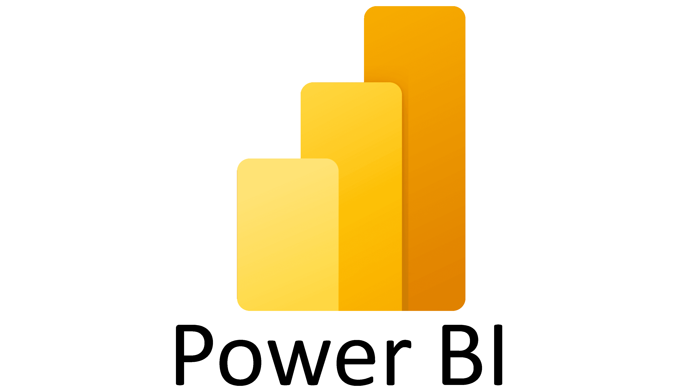


Why should I use dash?
Standard tools to create dashboards have a lot of functionalities for filtering data and creating plots.
They are meant to be used by non-coders.
For the most part they work well. However, they have some disadvantages.

Slide 8
Why should I use dash? Pros and cons of standard dashboard creation tools
Pros:
Very easy to learn.
No coding experience needed.
Not expensive.
Most general visualization options are available.
Allows for data connections and filtering
Cons:
Restricted to default visualization options.
Imposible to create advanced or highly customized graphs.
Data processing limited.
No options to set specialized user experience.

Slide 9
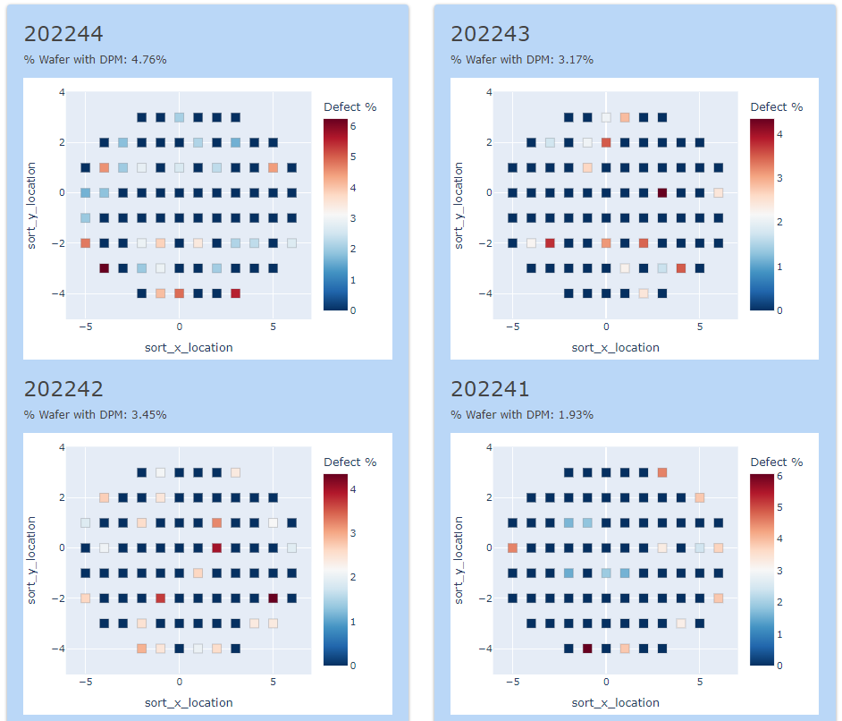
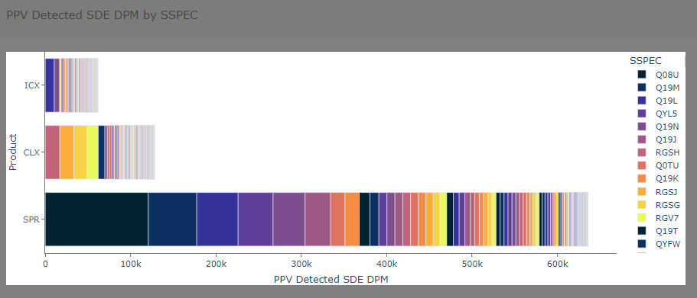
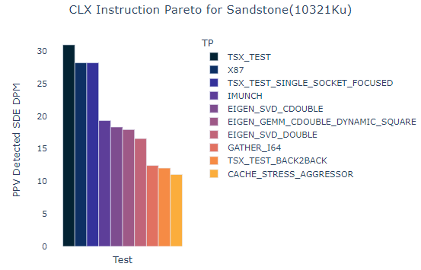
Why should I use dash? Why did we move to dash: graphic and UI/UX requirements.
An UI example from WANDA
A graphic example from Silent WANDA

Slide 10
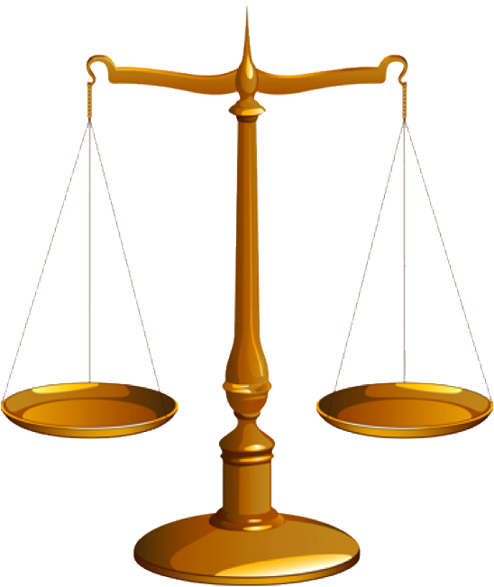

Why should I use dash?
Build a dashboard in which we could customize it without the restrictions of a standard dashboard creation tool.
Don’t need/want an overly complicated web resource which could take up learning and technical resources.
NAME OF SESSION

Slide 11


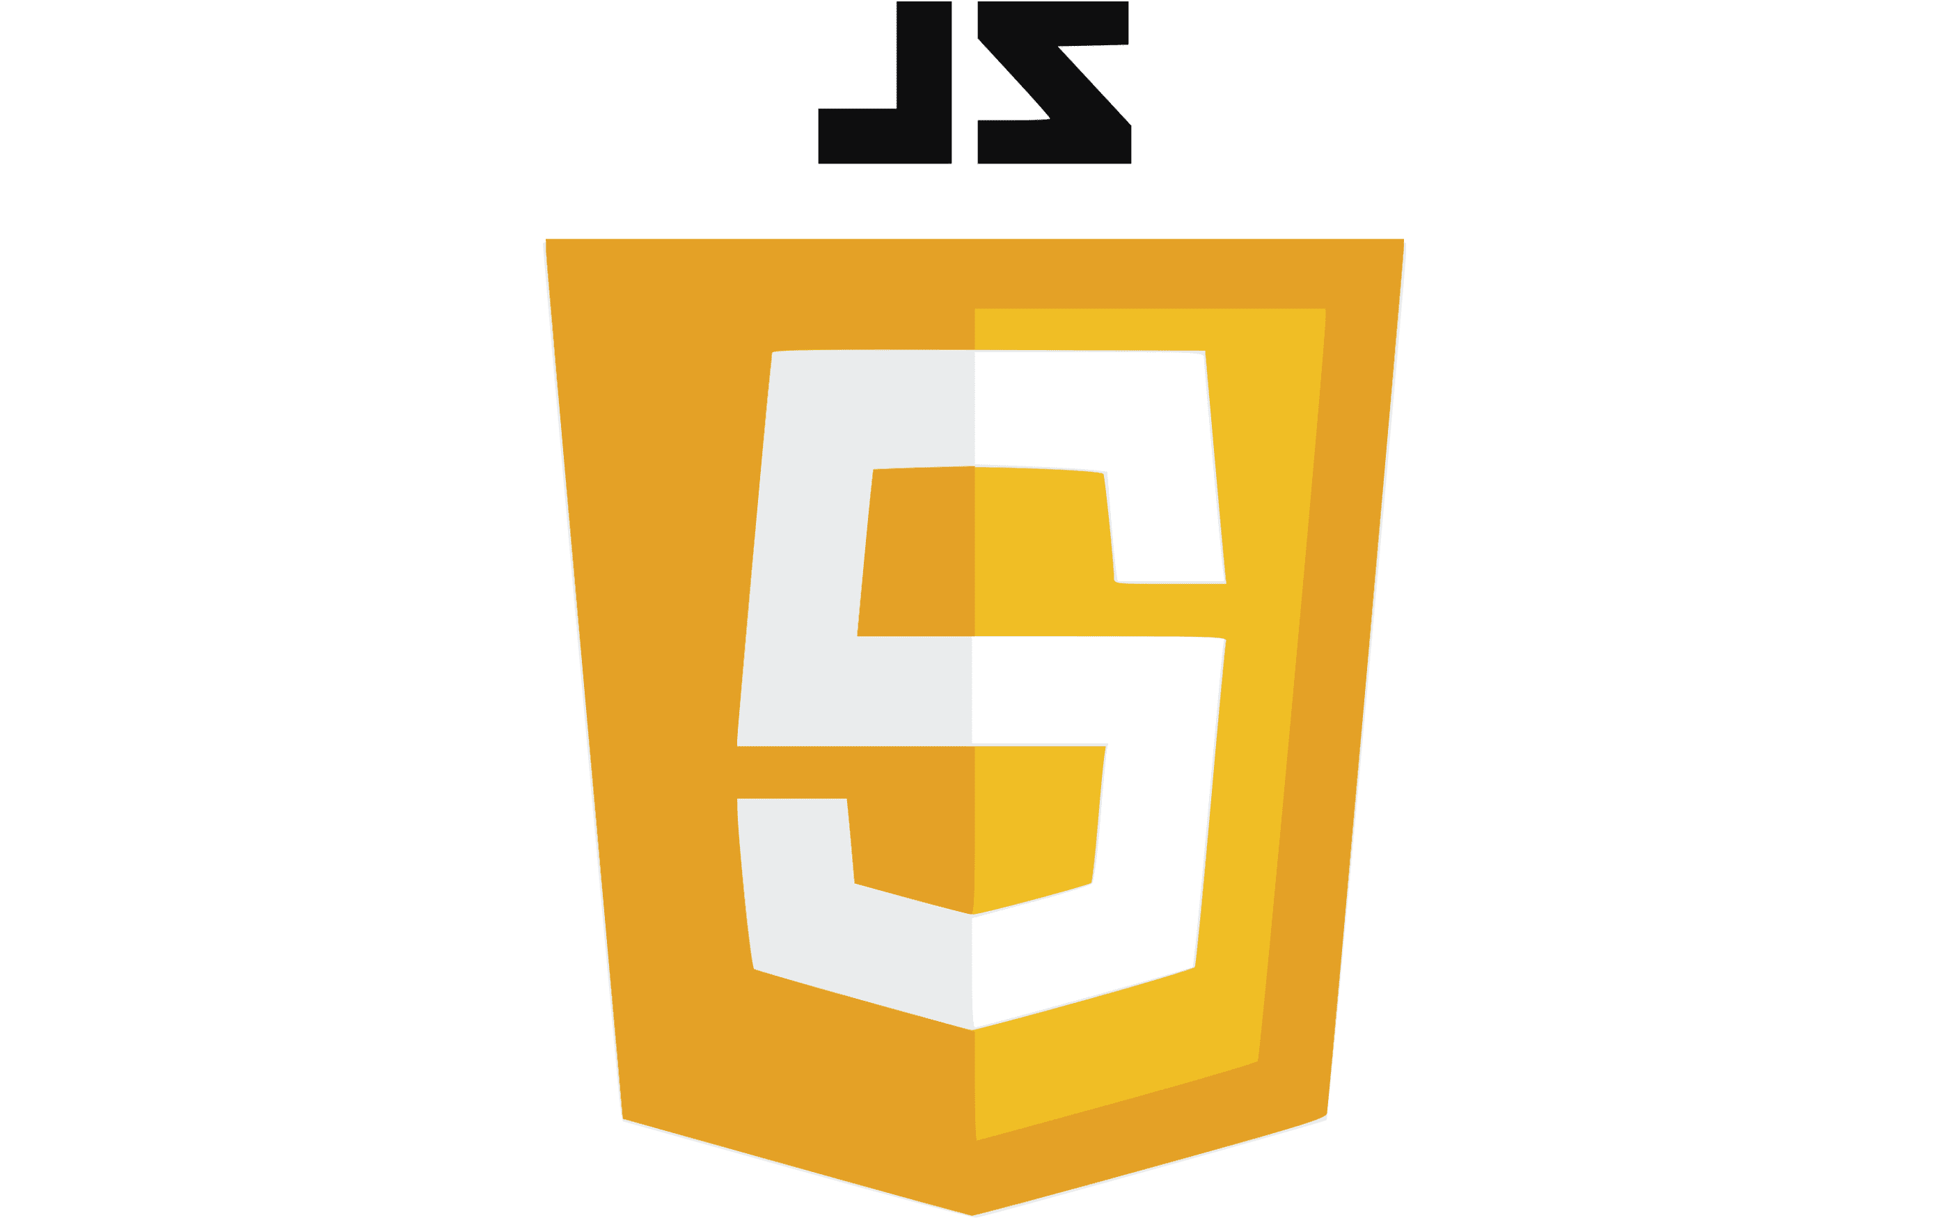
Why should I use dash?
With expanded web design we might have more responsibilities:
html/css for interface web design and styles.
javascript/typescript for web functionalities.
Others like flask/php for routes and submissions management.
A lot to learn there …
Luckily: dash combines all these requirements in an easy to learn, standard structure !

Slide 12

Usage of dash
Dash is a python library. Dash’s official description is:
Downloaded 800,000 times per month, Dash is the original low-code framework for rapidly building data apps in Python, R, Julia, and F# (experimental).
Written on top of Plotly.js and React.js, Dash is ideal for building and deploying data apps with customized user interfaces. It's particularly suited for anyone who works with data.
You can install it with pip and get going with it.
NAME OF SESSION

Slide 13
Usage of dash: where dash contributes.
We use dash in to create our dashboard (Frontend).

Slide 14

Usage of dash Core idea:
Layouts:
Visual elements of your dashboard.
Callbacks:
How the visual elements interact with each other.

Slide 15
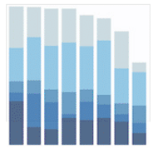
Usage of dash: layout-callback high level example:
Layouts:
Visual elements of your dashboard.
Callbacks:
How the visual elements interact with each other.
function:
If value of dropdown1 == ‘The’: data_filter = data where final_bucket == ‘The’
graph1 == a bar-chart using data_filter
Graph “graph1”
Dropdown : “dropdown1”

Slide 16

Usage of dash: advantages of the layout-callback model
Intuitive.
Layout allows for freedom in UI design.
Using identifiers for objects in Layout, you can specify the interaction between objects in your callbacks.
Callbacks allows for freedom with python scripting.

Slide 17

Usage of Dash: basic structure of a dash object.
app.py
from dash import Dash, dcc, html, Input, Output
app = Dash(__name__)
if __name__ == '__main__’: app.run_server(debug=True)
Dash is based in Flask, a python web framework.
Creating a dash object will open a localhost with your web application

Slide 18
Usage of Dash: basic structure of a dash object.
app.py
from dash import Dash, dcc, html, Input, Output
app = Dash(__name__)
#Layouts :
app.layout = ...
#Callbacks :
@app.callback(...)
def update_output(input_value):
return ...
if __name__ == '__main__’: app.run_server(debug=True)
Once an app object is created, you’ll need to add the two components:
Layout: is created specifying the layout attribute of the dash object.
Callbacks: they are done using decorators on the dash object and functions.

Slide 19

Usage of Dash: basic structure of a dash object.
In the following two sections we will:
Study how to create a layout in dash, which can be done completely in python.
Present the basic structure of a dash callback, and how to connect visual componente between each other.

Slide 20

Creating a layout: completely customize your design!
To create layouts, we need further dash extension libraries.
Your Layout will be a list of components. (each component is a visual element of your page).
Components in a layout can be divided into three types:
html components:
For example: containers and text annotations.
Core components:
For example: dropdowns, sliders, inputs, buttons.
Bootstrap components:
Extra components based on bootstrap design.
from dash import html
from dash import dcc
import dash_bootstrap_components as dbc

Slide 21
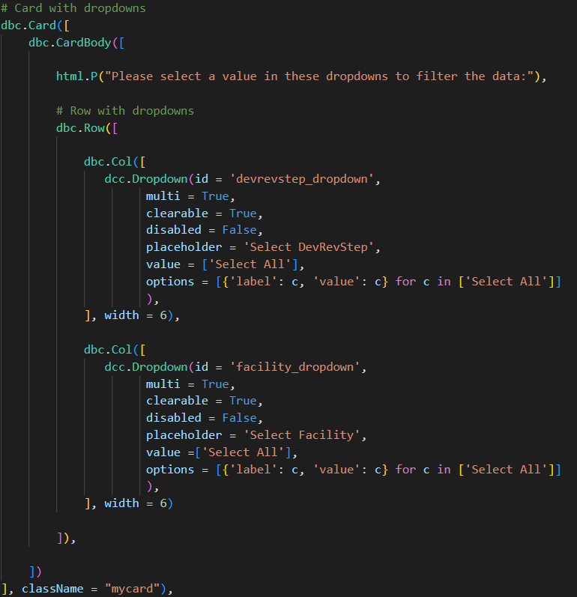
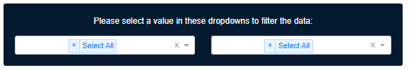
Creating a layout: completely customize your design!
Visually
In code:

Slide 22
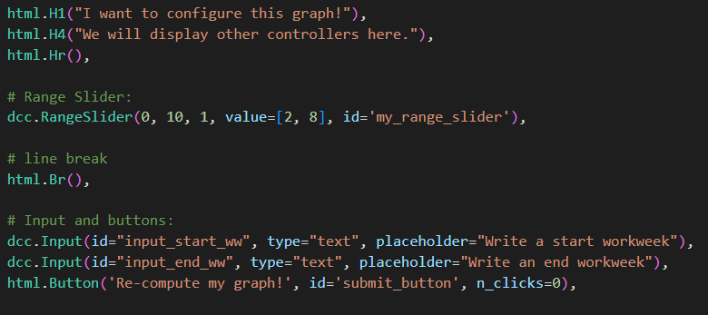
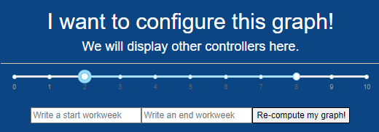
Creating a layout: completely customize your design!
Visually
In code:

Slide 23
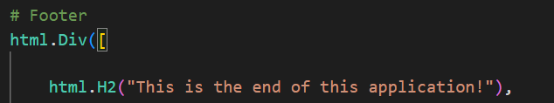
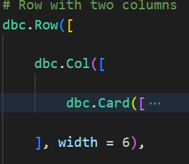
Creating a layout: completely customize your design!
html text tags:
html div’s
dbc Rows and Cols:
(12 columns per row)
Using bootstrap we can employ the Row – Col scheme.
There are 12 columns per row.

Slide 24
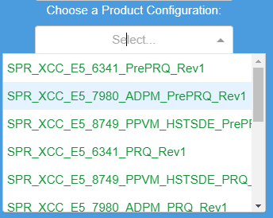
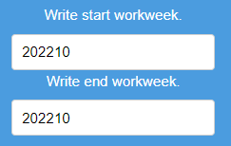
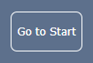
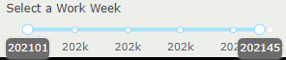
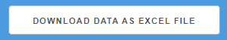
Creating a layout: completely customize your design!
dcc.Dropdown
dcc.Input
dcc. RangeSlider
dcc.Button

Slide 25
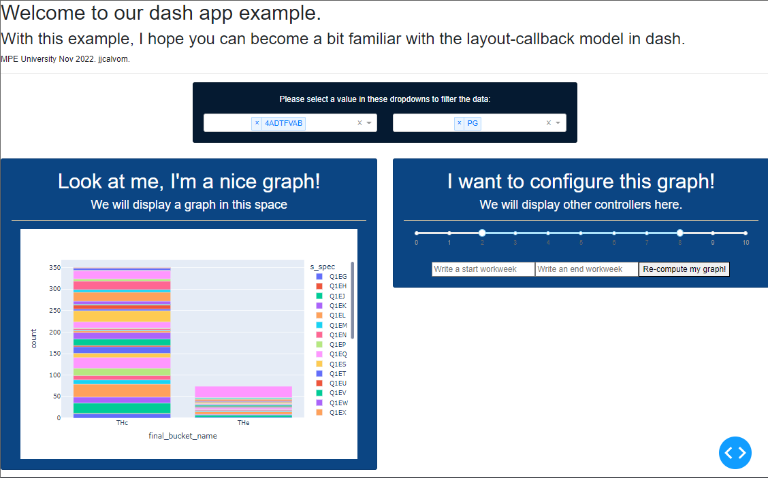
Creating a layout: completely customize your design!
Let’s see an actual example in action of creating components.
Suppose you are interested in creating the following dashboard design:
How to set it up using dash?

Slide 26

Developing callbacks: what’s going to happen in your dashboard?
Input object
All callbacks are functions with decorators over the app object.
A callback uses the input values of elements in the layout to compute the output values of other elements.
This callback will be triggered when the input objects’ values change.
Value
Callback
Value
Output object

Slide 27
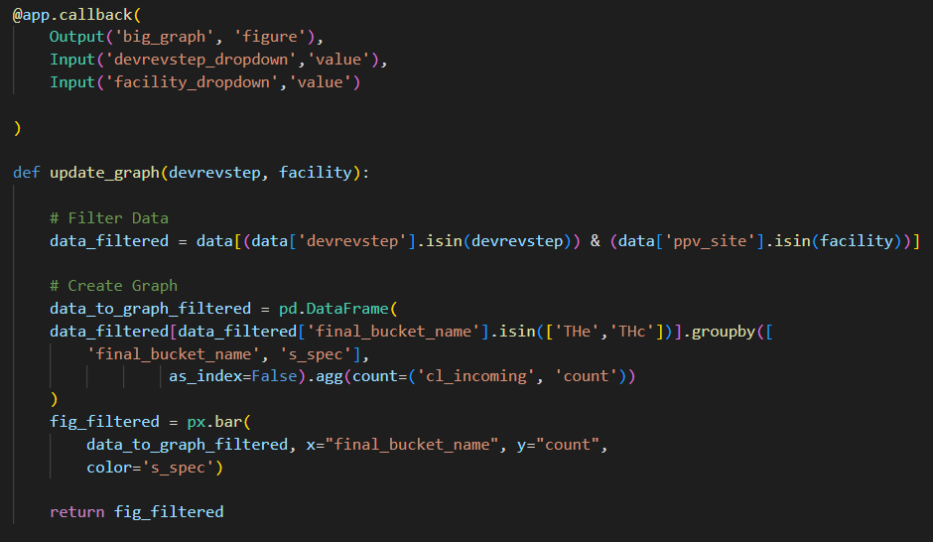
Developing callbacks: what’s going to happen in your dashboard?
A callback example
You can alter several outputs and combine various inputs as well.
No output can be triggered by two callbacks though.
This is a very intuitive and simple way of setting up web functionalities, however it is very powerful.
Can you think of the possibilities?

Slide 28
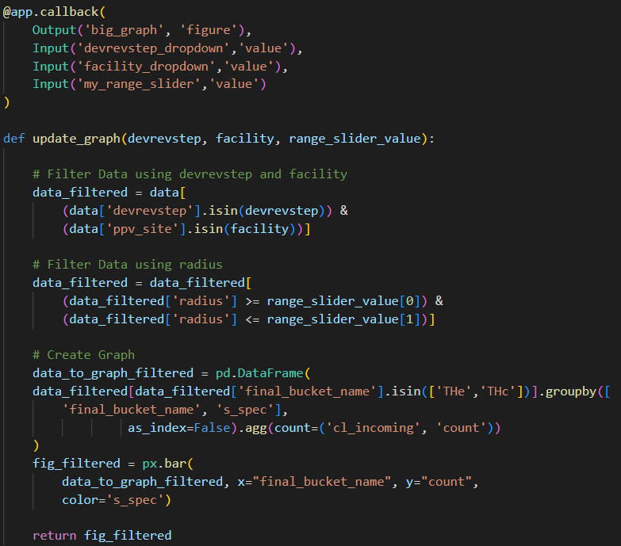

Developing callbacks: what’s going to happen in your dashboard?
Callbacks can alter values of components, but they can also alter the layout.
The output options could be graphs, values, or even html contents.
Wow, that gives us more possibilities!
What do you think this callback is doing?

Slide 29
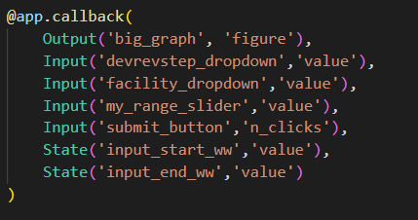
Developing callbacks: what’s going to happen in your dashboard?
Recommendations:
Put a unique id to each element of interest in your layout.
Use the options: Input or State for callbacks when controlling the trigger of a callback.
State option allows you to not set up a callback trigger when a particular value changes.
Example of usage of State option.

Slide 30
Developing callbacks: what’s going to happen in your dashboard?
In our demo example let’s see callbacks that do the following:
Update the plot on the left using the values of DevRevStep and facility.
Update the plot on the left by filtering radius between the values of the range slider.
Update the plot using input start and end workweeks, but only when button is clicked.

Slide 31
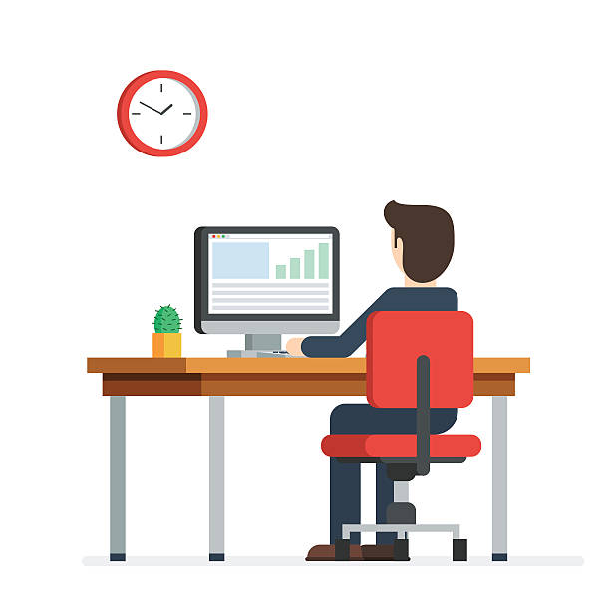
Advanced options: more resources at your disposal.
Memoization:
allows you to bypass long computations by storing the results of function calls
Circular Callbacks:
can be used to keep multiple inputs synchronized to each other.
Catch errors and prevent Update:
In certain situations, you don't want to update the callback output.
And many more:
https://dash.plotly.com/advanced-callbacks
Let’s see some examples

Slide 32
More advanced options: more resources at your disposal.
Using javascript to override Dash template.
Using further extensions as dash datatables or dash tabulator
Upload and Download files

Slide 33
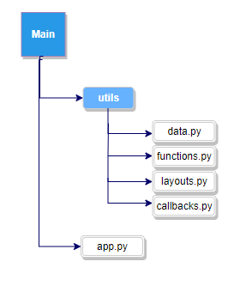
Suggested scaffolding for your application.
When dashboards increase in complexity using one script can be inefficient.
You should spread the layout-callbacks concerns in different folders.
This is the suggested approach to use:

Slide 34



Publishing a dash app at intel.
Using Cloud Foundry’s python build pack it’s relatively simple to deploy a dash app under an application org.
Check out Sarah Hedberg’s presentation: Hosting a dashboard through Intel Cloud Foundry

Slide 35

Thank you!
I hope that with this presentation you were able to:
Acknowledge the advantages of using dash for the creation of dashboards.
Understand the basic layout-callback model behind dash.
Become familiar with layout and callback construction at a basic level.
NAME OF SESSION

Slide 36

goto/mpestats
Contact us!
MPE SDA team is open to help or consultation requests.
MPE TLO APF SDA

Slide 37

Share Your Input
We need YOUR feedback to improve for next time!
Please tell us how we did:
goto/MPEUsurvey
MPE Global University Survey

